Slide 1
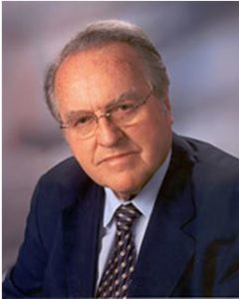
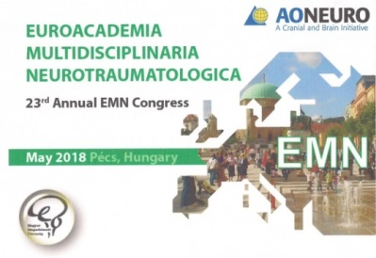
Obituary Franz Gerstenbrand September 6, 1924 - June 30, 2017
Euroacademia Multisiciplinaria Neurotraumatologica sadly mourn the passing Franz Gerstenbrand, emeritus Professor of Neurology at Innsbruck University, Founder and Past President of the EFNS and Honorary Member of the EMN and EAN, who died last year at the age of 92.

Slide 2
Some personal thoughts and memories
Franz was born in Hof, a small city of Northern Moravia (part of the Czech Republic) –where he still owned a private vineyard until he died. Having finished his school in 1942, he was immediately recruited into the German Airforce, where he served until May 1945. This WAR experience shaped his total life, whilst his medical and social- political behaviour and competence were influenced by two great personalities: Hans Hoff, Professor and director Psychiatric- Neurological University Department of Vienna, teacher during his speciality training. And Bruno Kreisky (22. 01.1911 – 29. 07. 1990) an Austrian politician, who served as Foreign Minister (1959 to 196 )and as Chancellor (1970 to 1983). He is considered perhaps Austria's most successful Socialist leader. Goethe came into my mind:” Two souls live oh in my chest”.

Slide 3
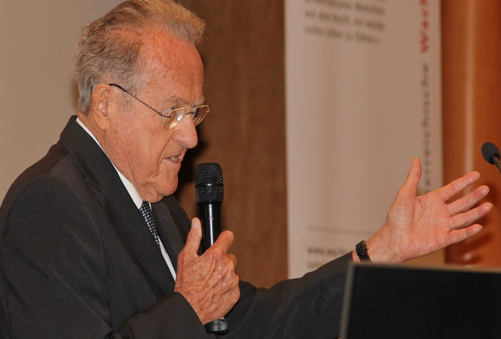
Opus magnum 1967 Traumatic Apallic Syndrome
Eur J Trauma Emerg Surg. 2007 Jun;33(3):268-92. doi: 10.1007/s00068-007-6138-1. Epub 2007 Apr 21.
Guidelines for Quality Management of Apallic Syndrome / Vegetative State.
von Wild K^{1,2,1}, Gerstenbrand F³, Dolce G⁴, Binder H⁵, Vos PE⁶, Saltuari L⁷, Alekseenko Y⁸, Formisano R⁹, Ritz A¹⁰, Ortega-Suhrkamp E¹¹, Jörg JR¹², Potapov AA¹³, León-Carrión J¹⁴, Vilcinis R¹⁵, Zitnay GA¹⁶.
BMC Med. 2010 Nov 1;8:68. doi: 10.1186/1741-7015-8-68.
Unresponsive wakefulness syndrome: a new name for the vegetative state or apallic syndrome.
Laureys S¹, Celesia GG, Cohadon F, Lavrijsen J, León-Carrión J, Sannita WG, Sazbon L, Schmutzhard E, von Wild KR, Zeman A, Dolce G; European Task Force on Disorders of Consciousness.

Slide 4
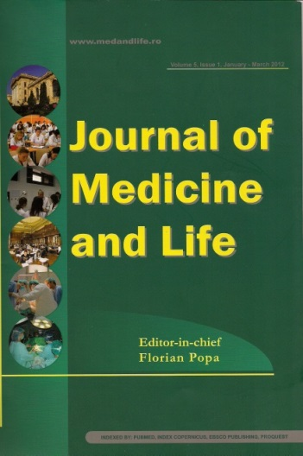
Vol.IV Special Issue 2011,2nd Ed. www.medandlife.ro pp 69-81
Prof. Dr.h.c. mult Franz Gerstenbrand was, for 5 ½ decades, one of Europe’s most eminent neurologists, and a “Founding Father” of the modern field of neurorehabilitation. Very early in his career, Franz developed an interest in aspects of what we now call “neurorehabili-tation”, e.g. working on disorders of motor and mental functioning. His skills in clinical observation prompted him to analyse comatose cases more deeply. He published about 1000 scientific papers! Through his interest in applying neuromodulatory techniques to spinal cord injury, he founded the Ludwig Boltzmann Institute in Vienna for Restorative Neurology. He expected new insight by MRI.

Slide 5
Franz had a lifelong appreciation of the importance of proprioception in human performance. By application of his indefatigable enthu-siasm for neuroscientific innovation, he extended this to space and under water neurology! When foot sole stimulation became his favorited physical therapy for arousing the brain-stem, subcortical, and cortical structures. He enjoyed being one of the Russian Cosmonauts external space adviser in Moscow. Stimulation for apallic and looked- in patients with fMRI captured his main interest (Graz and Salzburg ) as well as Underwater Medi. and Ethics till his end - linked to hyperbaric oxygenation after TBI and questions of amelioration of non treatable diseases. Franz, a convinced European, established the EFNS with help of the East-Europ. POLA- Symp. & WFNR Hon. Member. Franz was the owner of numerous internatio-nal high and highest awards. We will miss his wisdom and warmth.

