Slide 1
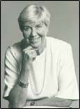
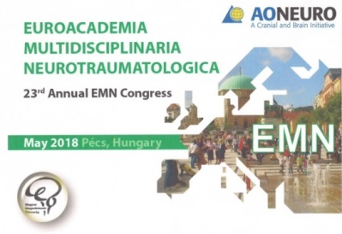
Anne-Lise Christensen 16.07.1927 - 11.02.2018 An Obituary
Anne-Lise Christensen, Adjunct Professor Emerita of Neuropsychological Rehabilitation, University of Copenhagen, died February 11, 2018. Anne-Lise was not only a central figure within Danish neuropsychology but had both domestically & internationally worldwide critical significance for the fruitful development of holistic rehabilitation of TBI persons. Having worked intensively during her various study visits with the Soviet neuropsychologist Alexander Romanowitsch Lurija (1902-1972) at Burdenko Neurosurgery Institute, Moscow University, she has internalized his theories on the functioning of the frontal lobe and the existence of zones of brain cells working in concert. Luria’s concept and way of holistic treatment became decisive for her life.

Slide 2
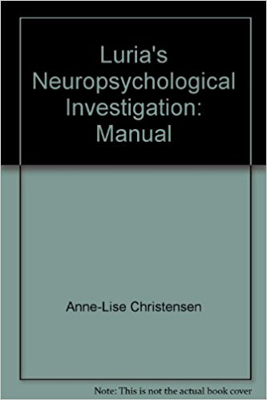
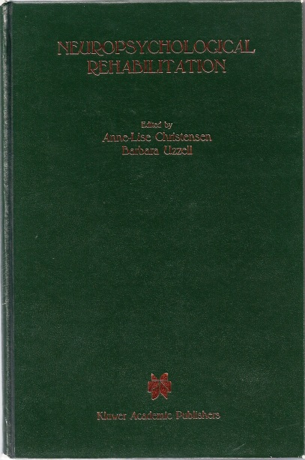
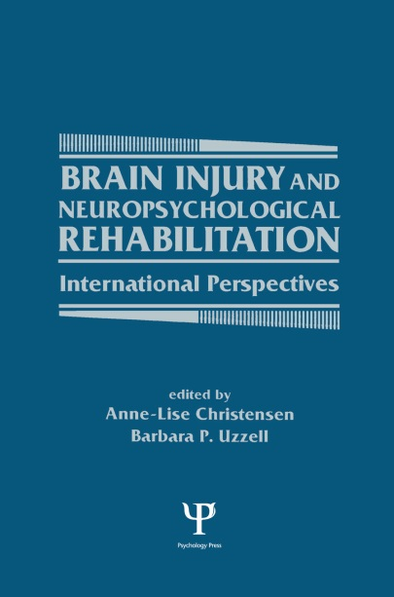
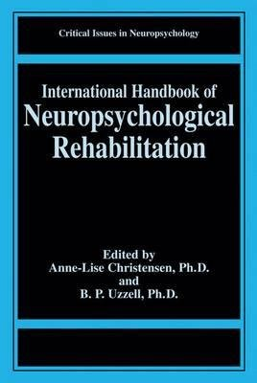
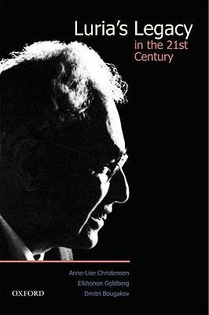
Publications, Key-Lectures, and numerous Seminars reflect her special clinical and scientific interest:
Munksgaard 1975
Kluwer 1988
Psychology P.1994
Kluwer 2000
Oxford U.P. 2009
1985 Int. Neuropsychological Society: European Conference, Copenhagen,
1987 Conference on Rehabilitation of Brain Damaged People: Current Knowledge and Future Directions. Copenhagen,
1990 Luria Lectures with participation Russian guest lecturers, Copenhagen,
1992 2nd Conference: Progress in Neuropsychological Rehab. Copenhagen, 1995 President IBIA 1st World Conference on Brain Injury, Copenhagen, 1997 Dres Christensen and Uzzell: 3rd Neuropsychological Rehabilitation Conference Copenhagen with Int. Handbook of Neuropsychol. Rebabil. 2000
2006 President 4th World-AMN: Bridging the Gap Between Brain and Mind.

Slide 3
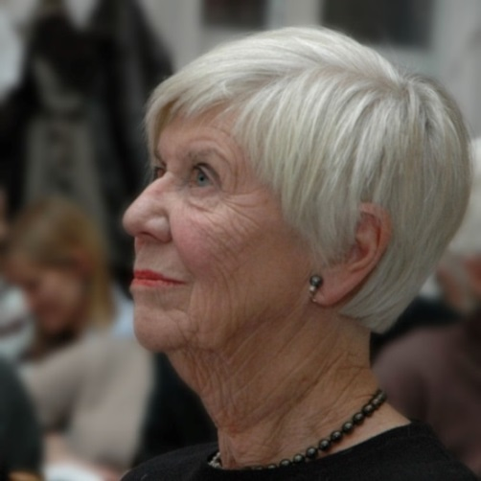
Prof. Anne-Lise Christensen became known as the founder & director of the 1st Centre for early post-acute neuropsychological Rehabilitation of TBI patients (CRBI) in Europe, University of Copenhagen1985-98
Achievements: 1987 Lady of the Dannebrogordenen (Order) is a means of honouring the faithful servants of the modern Danish state. 1982-85 Gov. Board Int. Neuropsychol. Soc., US. 1989-92 Europ. HELIOS Commission & National HI Foundation Member, Pennsylvania. Advisory Board Soc. for Cognitive Rehabilitation Inc.,US & IBIA, US & EBIS, EU. 1997 Dr.phil.h.c. external lecturer Univ. Lund, SWE; Sheldon Berrol, MD Senior Lecturer Award, Philadelphia,US; Distinguished Lecturer in Neuropsychology Diploma Swedish Neuropsychological Society; Hon. Member Danish & Finnish Neuropsychol. Societies. 1998 Int. Faculty Member of Sarah Network Hospitals Brasilia. 2000 Honorary Member EMN, 2004 WFNR, 2007 World-AMN; 2012 Lifetime Achievement IBIA in recognition for her influence on neurorehabilitation. 1999 onward Executiv Board Member QOLIBRI, HRQoL assessment tool, and Society.

Slide 4
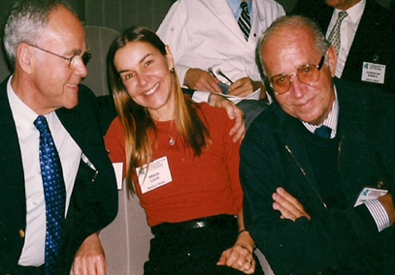
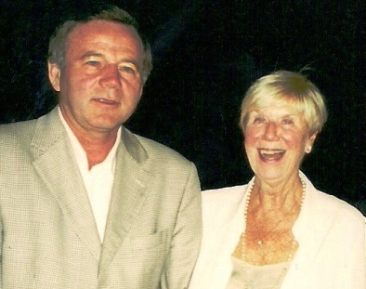
Anne-Lise started as Master of Arts in Psychology at the Psychiatric Dept. University Hospital of Aarhus 1959-61, where she worked at the Neurosurgical Dept. from 1962- 68. Here they did understand her psychological assessment and help as an adjunct in neurosurgery. That’s might explain why she loved neurosurgeons ever since! Than 1969-81 she was Head of Clinical Psychological Dept, Psychiatric Univ. Hospital. A.
Alexander A.Potapov 6 th EMN President, 2001, 14-17. 05 Burdenko NSI
Aloysio Campos da Paz jr,,
6th EMN, Moscow, 2001, EMN Correspoding Member
Died in January of 2015
Prof. Orthop,& Founding Director da Rede SARAH Hospitals
Lucia Willadino Braga, PhD Neuropsychologist,
Alexander Konovalov& Anne-Lise
Hon. Members 5th EMN Paris,2000,9.21 friends since her times with Luria at A.N.Konovalov‘s Burdenko NSI,Moscow.
Andrew Maas, 2005, 10th EMN President David Mendelow, EMN President, KvW

Slide 5
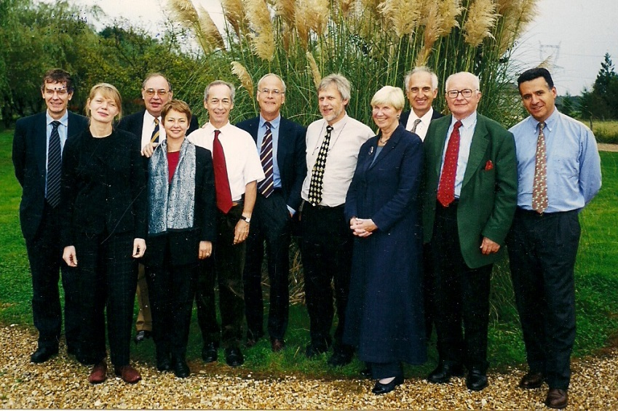
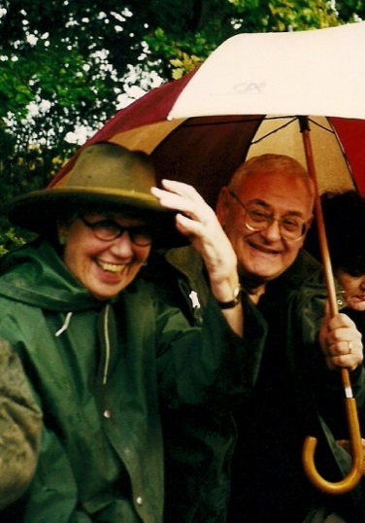
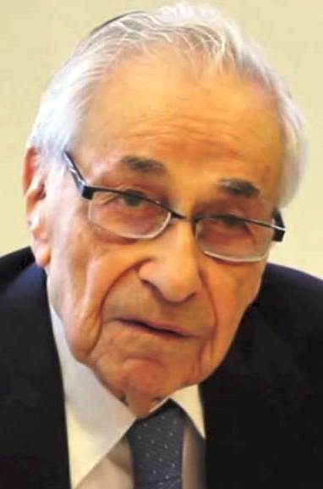
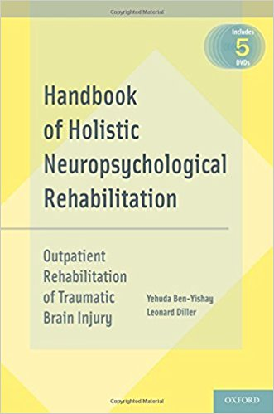
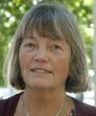
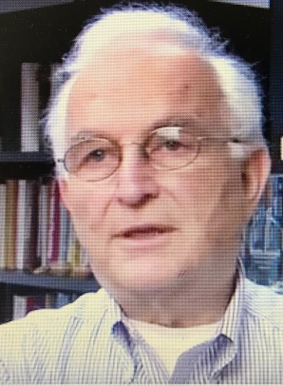
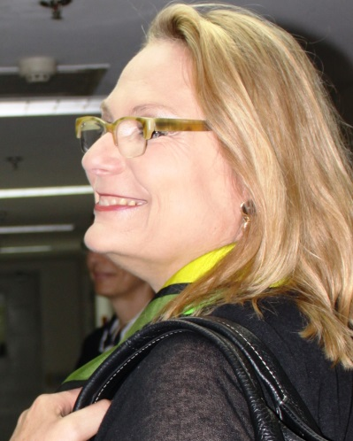
Some of Anne Lise‘s best old friends:
Jean-Luc Truelle, President 5th EMN Paris,&
Fontainebleau, Chair EMN Task Force –TBI “QOLIBRI”,who met A L in Aarhus in the 80’s “We danced minuet with the disabled!”
Yehuda Ben-Yishay, NY
Prof Clinical Rehab at wild deer rutting, Fontainebleau
„George & Nik“ Neuropsychologists George P. Prigatano, Prof. Barrow Neurological Institute, Phoenix, AZ– left-
Elkhonon Goldberg LURIA’s master pupil & Now Prof. at Dept. Neurology NY
Nicole von Steinbüchel, Prof. Dr. hum. biol., Dipl Psych.Dpmt Med Med.Soc. Univ.Göttignne
Chair QOLIBRI
President AMN
Met AL in 1989
Barbara.A.Wilson,Ph.D D.Sc., Cpsychol , UK Chair SIG WFNR Donald G. Stein, Ph.D. Asa G. Candler & Distinguished Professor
Emergency Medicine Orgeon,USA
Leonard Diller, Prof. Clin Psychology NYU

Slide 6
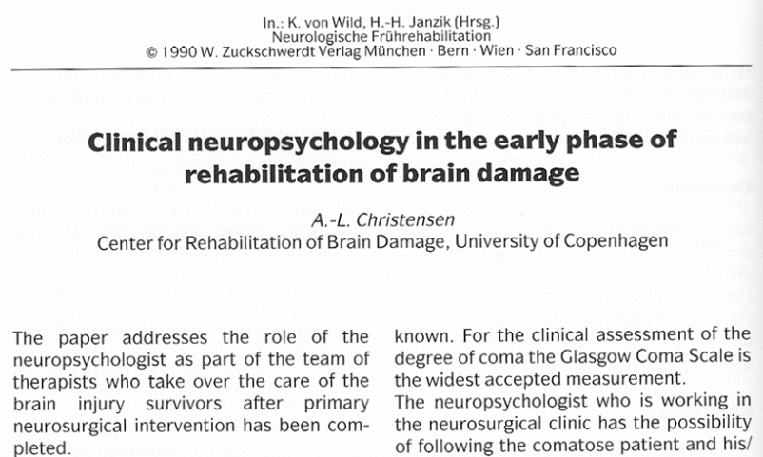
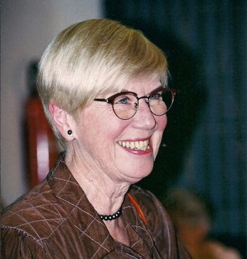
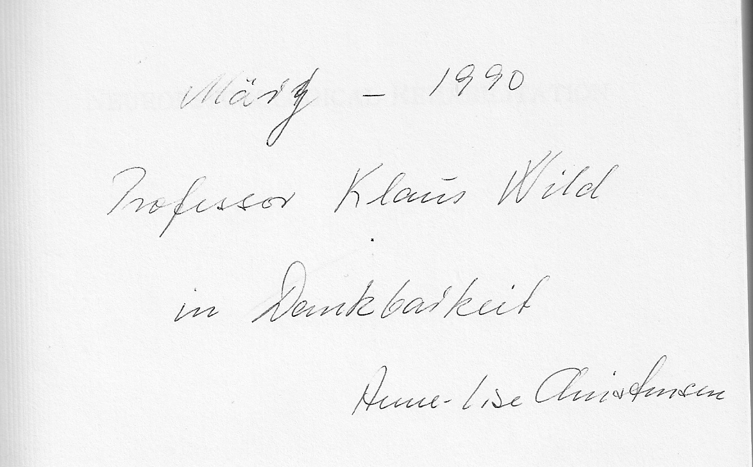
We met first when she was the representative of European HELIOS TBI Commission and our distinguished guest speaker at our 1st International. Congress on Early Neurological Rehabilitation in Münster, DE, March 21-24,1990 - see her kind dedication of her Congress book (with B. Uzzell):Neuropsycholog. Rehabil.1987. It was the begin of an enriching friendship, dedicated to mind and neuroscience, HRQoL after TBI, as well as on art, literature, and music! In the end, after she has broken her hip, she underwent postop. rehabilitation and was finally cared in a nursing home, where she passed away peacefully, surrounded by her family. Anne-Lise has introduced me as a neurosurgeon into her world of neuro-psychology & rehabilitation to care about social competence and a better HQL of TBI patients. The begin of QOLIBRI was with our EMN members! Joint activities will always hold fond memories for me: A pioneer neuro psychologist, bright, intelligent, head-strong, charming, beautifully dressed lady in a men dominated society- a bouquet of mind and love.

